Slide 1

Secure Online Voting
Debabrata Bhattacharya
Poulamee Thakur
Trisha Ghosh
Soumya Dutta

Slide 2
Contents
Introduction
Our System
Steps to be followed
Technology Leveraged
Target Audience
Screenshots

Slide 3
Introduction
Online voting or E-voting refers to voting using electronic means to either aid or take care of the chores of casting and counting votes.
The proliferation of personal mobile devices in the form of tablets and smartphones, based on the Android operating system, presents a unique opportunity to empower isolated communities who traditionally have had a difficult time voting.
The project suggests the use of hashing. Authentication is made by comparing hashes using SHA-256.
The system is more secured.
Vote can be audited later by comparing hashes in a database.

Slide 4
Our System
Relevant agencies tasked with conducting the election shall make use of the National Electoral Roll database and send all registered voters a letter with information about the voting process.
The user opens the app and scans 2 pieces of information from the letter:
1. Information that authenticates him and his vote
2. The code that indicates his vote

Slide 5
Our System
These two pieces are not stored but immediately collected by the Google Gmail App. A ready-to-send email is generated with the two pieces of information.
The user can then send the email.
Gmail's built in header auditing and caching infrastructure will ensure that the email reaches its destination safe from mal-actors such as hackers, phishers, etc.
The government can then audit the vote itself with the relevant information provided, ensuring a reliable and rigorous election.

Slide 6
Steps To Be Followed
1. User receives a letter with scan-able information.
2. User opens the app and scans his own information as well as the candidate he chooses to vote for.
3. An email in the Gmail App is automatically generated with encrypted data.
4. The user sends this email.
5. Email received is used to count votes for candidates.
6. The received email is verified and will count as a single vote.
7. The vote can be audited by verifying hashed user information.

Slide 7
Technologies Leveraged
Gmail is a zero-price, advertising-supported email service developed by Google. Users can access Gmail on the web and through mobile apps for Android and iOS.
Android is a mobile operating system developed by Google, based on the Linux kernel and designed primarily for touch screen mobile devices such as smart phones and tablets.
ZXing ("zebra crossing") is an open-source, multi-format 1D/2D barcode image processing library implemented in Java, with ports to other languages.

Slide 8
Advantages
1. The system can be used anytime and from anywhere by the Voters.
2. No one can cast votes on behalf of others and multiple times.
3. Saves time and reduces human intervention.
4. The system is flexible and secured to be used.
5. Unique Identification of voter through user info hashes.
6. Extremely secure system with one time password.
7. Improves voting with friendly Android Interface.
8. No fraud vote can be submitted.

Slide 9
Target Audience
➢ Citizens who wish to vote in privacy of their homes
➢ Citizens who vote in violence-prone areas
➢ Citizens in remote areas who have difficulty in reaching voting stations
➢ Citizens who have difficulty in reaching voting stations due to lack of infrastructure in underdeveloped areas

Slide 10
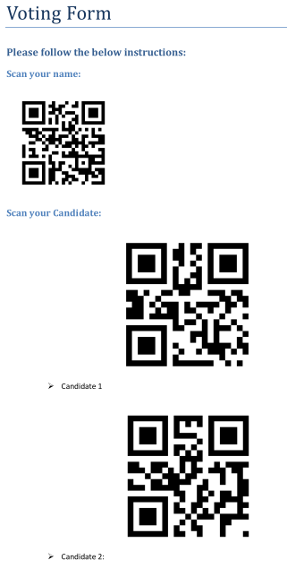

Screenshots
Voting Form
Splash Screen

Slide 11
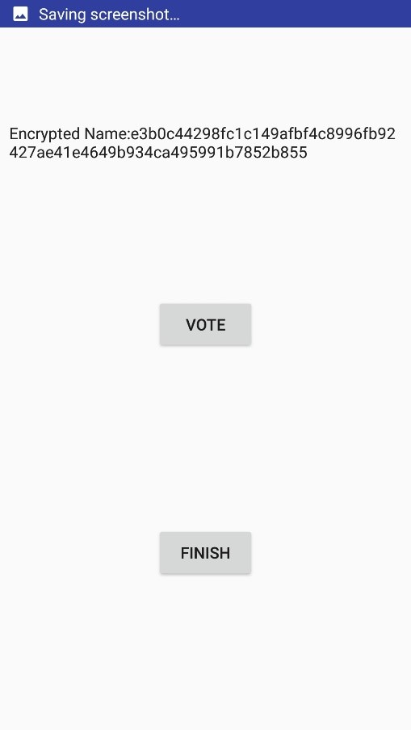
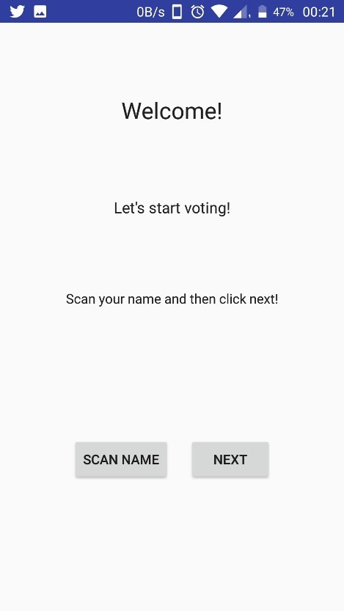
Screenshots
Welcome Screen
Voting Screen

Slide 12
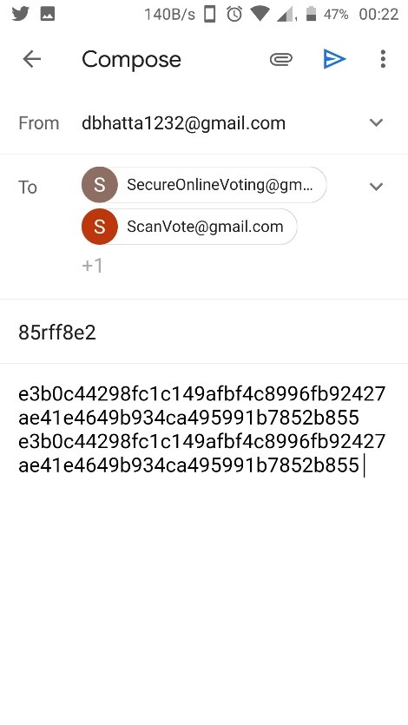
Screenshots
Email Screen

Slide 13
Conclusion
By online voting system percentage of voting is increases and cost and time of voting process is decreases.
It is easy to use and it is less time consuming.
It is very easy to debug.

Slide 14
Thank You!!

